Slide 1
Getting Started
Notes:
Introduce two simple sorting methods, then compare the pros and cons

Slide 2
2.1 Insertion Sort: An algorithm that can efficiently sort small numbers example:
524613
254613
245613
245613
124563
123456
Notes:
Scan from left to right, sweeping to a number, Just check that number from the left and insert it into the appropriate position.

Slide 3
2.2 Analyzing Algorithms
RAM: Random-access machine, It takes only one unit of time to perform memory access on this machine, and the instructions are executed one by one.
Running time: The total number of steps performed, expressed as a function of input size.

Slide 4
example: Insertion Sort
Insertion-Sort(A)
1 for j ← 2 to length[A]
2 do key ← A[j]
3 ►insert A[j] into the sorted sequence A[1..j - 1]
4 i ← j – 1
5 while i > 0 and A[i] > key
6 do A[i + 1] ← A[i]
7 i ← i – 1
8 A[i + 1] ← key
T(n) = c₁n+(c₂+c₄+c₈)(n-1)+c₅ +(c₆+c₇)
cost
c₁
c₂
0
c₄
c₅
c₆
c₇
c₈
times
n
n - 1
n - 1
n - 1
n - 1

Slide 5
Best-case:
Each t_{j}=1. (Input A is sorted)
T(n) = (c₁+c₂+c₄+c₅+c₈)n-(c₂+c₄+c₅+c₈)
= Θ(n)
(rate of growth, order of growth)
Worst-case: (upper bound)
Each t_{j}=j.
T(n) = k₁n² + k₂n + k₃
= Θ(n²)
Notes:
The best case is when the input is sorted, the time spent is proportional to n.
In the worst case, the input is the opposite of the last sorted result, and the time it takes is proportional to n².

Slide 6
Average-case: (Expected running time)
Each t_{j}=j/2
T(n) = t₁n² + t₂n + t₃
= Θ(n²)
(rate of growth, order of growth)
Notes:
On average, the time required for insertion sort is proportional to n².
According to the probability, when the number t_{j} is checked forward, it will stop on average by j/2 steps.
The best time to stop, the worst case is that j steps will stop.

Slide 7
2.3 Designing Algorithms
Divide-and-Conquer:
Divide: (Cut the big problem into a few smaller ones)
Conquer: (Solve the problem)
Combine: (A solution to the problem of solving a small problem)

Slide 8
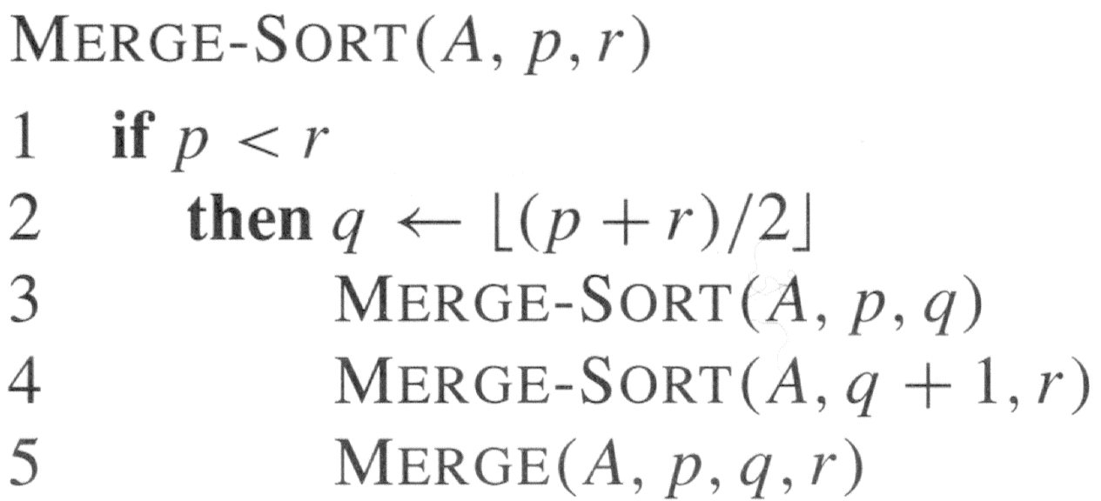
example: Merge Sort
Notes:
Merge sort is a classic example of divide-and-conquer.
To sort a bunch of numbers, it will be cut into several small numbers until it is cut into a number.
Then merge the answer (Merge) and combine the solution of the small problem into the solution of the big problem.

Slide 9
sorted sequence
12234566
merge
2456
1236
merge
merge
25
46
13
26
merge
merge
merge
merge
5
2
4
6
1
3
6
2
The sorted columns that are combined will be incremented from bottom to top. (For example, the bottom layer is 1, the second to last is 2, and the top is 8)
Notes:
The bottom-ordered length is 1 (we will have a bunch of sorted columns of length 1)
The second-to-last sorted length is 2 (we will have a bunch of sorted columns of length 2)
The length of the last k-th layer is 2k.
By analogy, if there are n numbers, the merge log(n) layer will end.

Slide 10
Analysis: (recurrence)
T(n) =
= Θ(nlog n)
Notes:
Chapter 3 will teach you the definition of Θ and other symbols,
In Chapter 4, I will teach how to analyze recurrence to get T(n)= Θ (nlog n)

Slide 11
Exercises
Problem 1:
Given a line of text, please help list the frequency of occurrence of ASCII characters. You can assume that the first 32 characters of ASCII and the last 128 characters will not appear. Each line of text may end with ‘\n’ and '\r’, but you don’t have to take those characters into account.
Input: A few lines of text will be given. Each line can be up to 1000 in length. The input ends with the end of the file.
Output: For each line of input, the ASCII value of the ASCII character is printed according to the frequency of the occurrence and the frequency at which the character appears (high frequency preprint). A blank line is printed between each set of outputs. If two ASCII characters have the same frequency, the ASCII value is printed with a smaller priority.

Slide 12
The following is an example of an input:
Sample Input | Sample Output
AAABBC 122333 | 67 1 66 2 65 3 49 1 50 2 51 3

Slide 13
Exercises
Problem 2:
The way to measure the degree of "chaos" in a sequence is to figure out that several pairs of numbers are not sorted in order. For example, in the sequence "DAABEC", the chaos according to the above metric is 5, because D is larger than the four letters to the right and E is larger than the one on the right. In fact, this irritating algorithm is the number of inversions in this sequence. The sequence "AACEDGG" has only one inversion (E and D), which is almost sorted; however, "ZWQM" has six inversions (almost no sorting, in fact just the opposite of sorting).
You are responsible for classifying a bunch of DNA sequences (sequences consist of only four letters A, T, C, G). However, you don't want to sort the sequences in lexicographic order, but rather according to their "no chaos", from "closest to the sorted sequence" to "nearly sorted sequences". All sequences have the same length.

Slide 14
Exercises
Input: The first line is an integer M, and then after a blank line, it will follow the M group. There will be a blank line between each group of measurements as an interval. The first line of each set of measurements contains two positive integers: n (0 < n ≤ 50) indicates the length of the sequence; m (0 < m ≤ 100) indicates the total number of sequences. Next there will be m lines, each of which is a DNA sequence of length n.
Output: For each set of measurements, the sequence from "closest to sort" is ranked to the "nearly sorted" sequence. If the chaos of the two sequences is the same, the first occurrence in the input file must be printed first.

Slide 15
The following is an example of an input:
Sample Input | Sample Output
1 10 6 AACATGAAGG TTTTGGCCAA TTTGGCCAAA GATCAGATTT CCCGGGGGGA ATCGATGCAT | CCCGGGGGGA AACATGAAGG GATCAGATTT ATCGATGCAT TTTTGGCCAA TTTGGCCAAA

